Slide 1
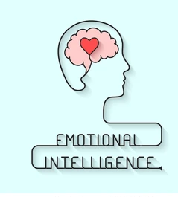
Emotional Intelligence

Slide 2
Learning outcomes
Basic understanding or the review of emotional intelligence
An understanding of how emotions affects relationships, work performance and your leadership development.
Practical skills that you can use immediately to support you with your ongoing personal development

Slide 3
“Anyone can become angry- that is easy. But to be angry with the right person, to the right degree, at the right time , for the right purpose, and in the right way- that is not easy.”
ARISTOTLE ,
The Nicomachean Ethics (350 BC)

Slide 4
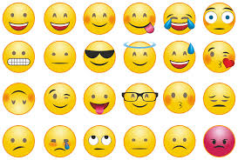

Slide 5
What is Emotion?
A feeling….
Your thoughts when you have that feeling….
Psychological and Biological state…
The range of behaviours that are acted out.

Slide 6
Primary and Secondary Emotions
Anger | Resentment, hostility…………………………………… hatred and violence
Sadness | Grief, sorrow, self pity …………………………………….depression
Fear | Anxiety, nervousness, wariness ……………………….phobia and panic
Enjoyment | Happiness, joy, contentment, ecstacy …………………mania
Love | Acceptance , trust, infatuation, ………………………….obsession
Surprise | Shock, astonishment, wonder, ……………………………offensiveness
Disgust | Contempt, scorn, aversion ………………………………….revulsion
Shame | Guilt, embarrassment , remorse, regret……………………………distress

Slide 7
How do we show or read emotions ? ‘Emotional Leakage’
Voice
Breathing
Skin, sweating
Muscle tone and movement
Energy level
Facial expression
Any other…. ?

Slide 8
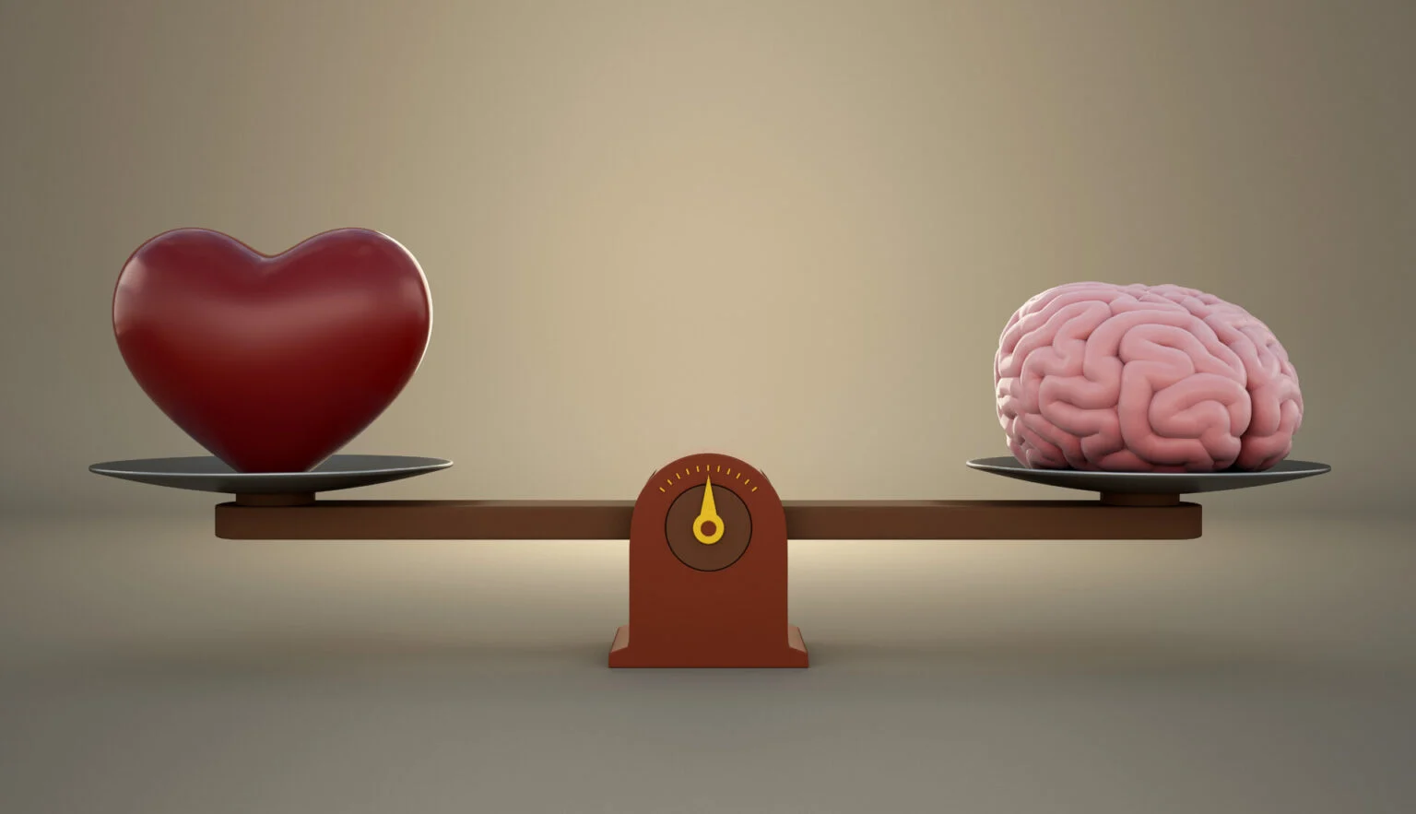
What is Emotional Intelligence (EI) ?
Emotional Intelligence is the “ability to monitor one’s own and other people’s emotions, to discriminate between different emotions and label them appropriately, and to use emotional information to guide thinking and behavior” (Salovey and Mayer, 1990).

Slide 9
Emotional intelligence refers to the ability to perceive, understand, and manage one’s own emotions and relationships. It involves being aware of emotions in oneself and others and using this awareness to guide thinking and behavior. Emotionally intelligent individuals can motivate themselves, read social cues, and build strong relationships

Slide 10
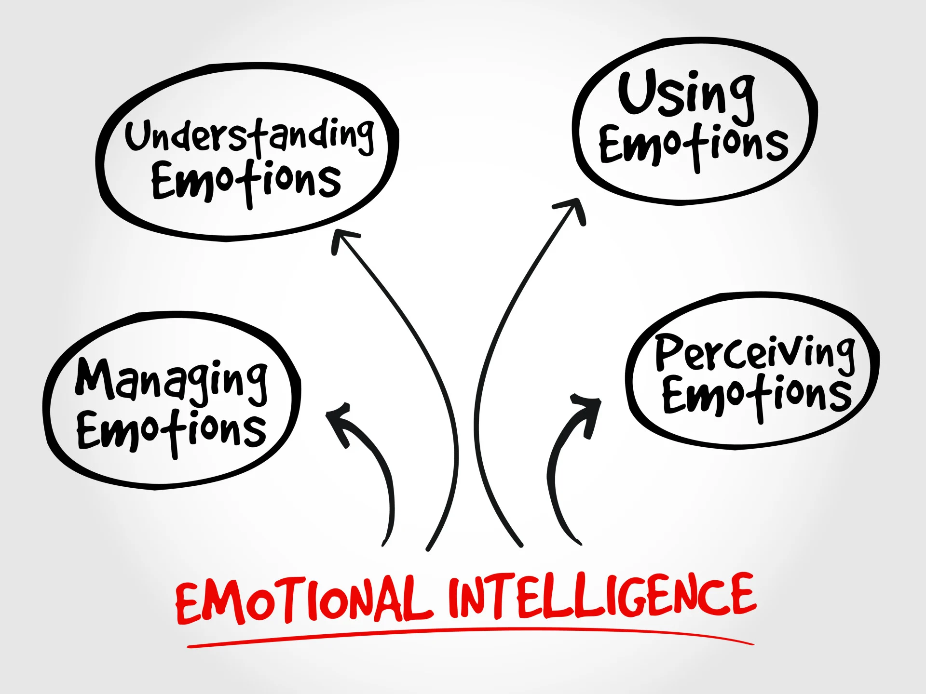

Slide 11
Key skills to work on to develop EI
Perceive emotions in oneself and others: emotional awareness
Understanding emotional meanings: understanding the patterns and behaviours associated with the display of emotions
Use emotions to facilitate thinking : the ability to harness emotions and apply them to tasks like thinking and problem solving.
Managing emotions: the ability to regulate your own emotions and the ability to cheer up or calm down another person.

Slide 12
Intelligence Quotient Vs Emotional Intelligence Quotient IQ vs. EQ
IQ (Intelligence Quotient): This is a score that measures your cognitive abilities, such as your ability to learn, reason, solve problems, and understand complex ideas. IQ tests typically involve solving puzzles, recalling information, and completing analogies.
EQ (Emotional Quotient): This is a measure of your emotional intelligence, which refers to your ability to understand, use, and manage your own emotions in positive ways to achieve your goals. It also includes your ability to understand, empathize with, and influence the emotions of others.

Slide 13
Intellectual ability or intelligence quotient (IQ) is not enough on its own to achieve success in life. Undoubtedly, IQ can help one get into university, but your Emotional Intelligence (EI) will help one manage stress and emotions when facing final exams.
IQ and EI exist in tandem and are most influential when they build off one another.
Emotional intelligence is also valuable for leaders who set the tone of their organization. If leaders lack emotional intelligence, it could have more far-reaching consequences, resulting in lower worker engagement and a higher turnover rate.

Slide 14
While one might excel at one’s job technically, if one cannot effectively communicate with one’s team or collaborate with others, those specialized skills will get neglected.
By mastering emotional intelligence, one can positively impact anywhere and continue to advance one’s position and career in life. EI is vital when dealing with stressful situations like confrontation, change, and obstacles.

Slide 15
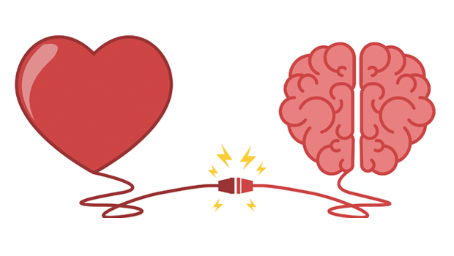
Emotional intelligence helps one build stronger relationships, succeed at work or school, and achieve one’s career and personal goals, as well as reduce group stress, defuse conflict, and enhance job satisfaction.
It can also help connect with one’s inner feelings, turn purpose into action, and make informed decisions about what matters most to oneself.
During these times, it is essential to remember to practice kindness, and being in touch with our emotions can help us do just that.

Slide 16
Are IQ and EQ Important?
Both IQ and EQ can be important for success in life. IQ can help you excel in academic settings and certain careers that require strong cognitive skills. EQ can help you navigate social situations, build strong relationships, and manage stress effectively. Some research suggests that EQ may even be more important than IQ for success in many careers.
Can You Improve Your IQ or EQ?
There is some debate about whether IQ can be significantly improved. However, there is evidence that you can develop your EQ skills through various techniques, such as mindfulness training, cognitive behavioral therapy, and social skills training.
Overall, both IQ and EQ are important aspects of intelligence. While they measure different abilities, they can both contribute to your overall success and well-being

Slide 17
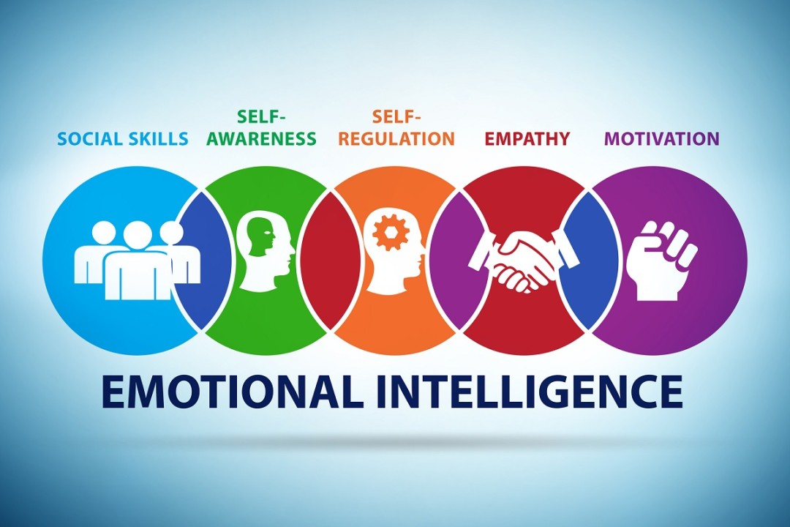

Slide 18
Self-awareness
Self-awareness is knowing what you are feeling when you are feeling it.
Developing self-awareness requires tuning in to your true feelings. If you can recognise and evaluate your emotions, you can manage them. The ability to recognise an emotion as it happens is the key.
Self-aware people recognise that there is a powerful connection between the things they feel and the way that they behave.
Self-aware people are able to identify and value their strengths and be realistic about their limitations. They can also learn from their interactions and are open to new experiences and information.

Slide 19
2. Self-regulation
Self-regulation is the skill of expressing your emotions at the right time, in the right place, and in the right way.
High self-regulation enables you to control your behaviour, emotions and thoughts in the pursuit of your long term goals and in ways which are consistent with your deepest held values.

Slide 20
Self-regulation Development Strategies
Mindfulness
“The awareness that arises from paying attention, on purpose, in the present moment and non-judgementally.” ~ Jon Kabbat-Zinn
Practices such as mindful breathing and gratitude enable us to connect with the space between stimulus and response leading to making appropriate choices in any situation.

Slide 21
Cognitive Re-appraisal
This involves choosing to change your thought patterns. This is done by reinterpreting a situation in order to change your emotional reaction to it.
Your partner showing up late does not imply that they don’t respect you; s/he may not respect time
Your child’s outburst may not be manipulation, but an inability to contain his/her fear

Slide 22
Acceptance
Sometimes situations cannot be changed or really are beyond our control. Acceptance is a powerful way to manage our emotions without needing to ruminate endlessly or sustain strong emotion for longer than is necessary.
Problem Solving
During a challenge, calmly looking at options and being creative with solutions is often a very empowering expression. Our thoughts are present- and future-focused and being constructive can go a long way to easing anxiety, reducing worry, avoiding distracting, or suppressing.

Slide 23

3. Motivation
Delaying gratification to pursue important goals and persevering when faced with setbacks or frustrations.
Emotionally intelligent people are intrinsically motivated and are interested in taking actions motivated by their inner needs and goals more than external rewards such as fame or wealth.
They tend to set goals, need to achieve, and look for ways to do things better.

Slide 24
Personal motivation requires clear goals and a positive attitude. We must ready ourselves in order to act on opportunities. Regardless of whether you have a predisposition to a positive or a negative attitude, you can, with effort and practice, think more positively.
People with greater emotional intelligence experience hope and optimism more often than those with less emotional intelligence.
Motivated people have less emotional stress.
Optimism protects people from apathy and depression. It can also keep people from blaming failure on a personal trait that cannot be changed.
If you catch negative thoughts as they occur, you can re-frame them in more positive terms which can help you achieve your goals.

Slide 25
4. Empathy
Empathy is sensing what others are feeling and seeing other perspectives.
Empathy is the ability to recognise another’s emotional state. The more skilful you are at discerning the feelings behind others’ signals, the better you can control the signals you send.
Empathy involves listening carefully, picking up on what people are truly saying, and responding accordingly. Stephen Covey describes empathy as listening for emotion, which in turn makes people feel understood.

Slide 26
To be more effective when being empathetic, try these techniques:
Recognise your own bias
People who are angry or in a bad mood notice another person’s bad mood more readily than another person’s good mood.
Put aside your own feelings
When you have your own “emotional agenda,” it interferes with your ability to empathise with other people’s feelings.
Be attentive to cues
Tell people what you notice, and ask for confirmation of what you’re sensing.

Slide 27

5. Social Skills
Social skills are our ability to interact with others comfortably and cooperate during those interactions.
Social skills allow us to connect with other people. Social awareness builds on the domain of self-regulation in that it allows us to access and express emotions in appropriate ways.

Slide 28
Among the most useful social skills are:
Influence — Wielding effective persuasion tactics.
Communication — Sending clear messages.
Change — Initiating or managing change.
Conflict management — Understanding, negotiating and resolving disagreements.
Building bonds — Nurturing instrumental relationships.
Collaboration and cooperation — Working with others toward shared goals

Slide 29
Emotional intelligence and leadership
Leading others
The ability to perceive, understand and respond to the personal feelings of others.
“Leadership is not about the domination… it is about the art of persuading people to work toward a common goal” (Goleman, 1995)

Slide 30
Leading Self
Recognising your emotions and acting on them in a reflective and a rational manner

Slide 31
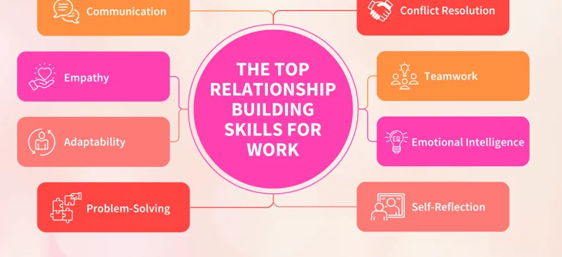

Slide 32
Daniel Goleman popularised the idea in his 1995 bestseller
“Educators believe if we can teach our children to manage emotions, we will have less bullying and more cooperation.”
“If we can cultivate emotional intelligence among leaders and doctors, we will have more caring workplaces and more compassionate healthcare.”

Slide 33
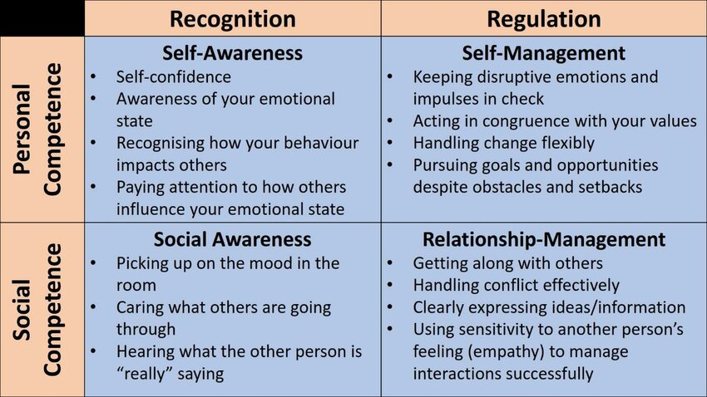

Slide 34
Goleman’s Emotional Competencies (inter-related domains)
Domains | Description
Self awareness | Knowing your moods, emotions and your drives, as well as their effect on others
Self regulation | The ability to control or redirect disruptive impulses and moods and the propensity to suspend judgement and think before acting
Motivation | A passion to work for reason that go beyond money or status and a propensity to pursue goals with energy and persistence
Empathy | Sensing what others are feeling, understanding other people’s emotional make up, the skill to treat people according to their emotional reactions and cultivating rapport with wide diversity of people
Social skills | Handling emotions in relationships well, accurately reading social situations, an ability to find common ground and build rapport. Skill in managing relationships and building rapport

Slide 35
